Slide 1
Practical Kinetics
Exercise 0:
Getting Started
Objectives:
Install Python and IPython Notebook
print “Hello World!”

Slide 2
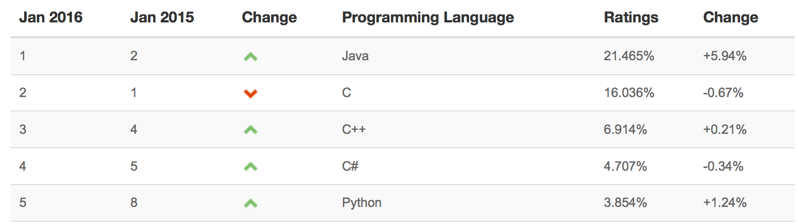
What is Python?
Python is a programming language that is:
1. Easy to use. It reads like English:
if temperature < 30:
print “Wear a hat.”
2. Free and widely used. It’s the fifth-most popular language in the world!
(Source: tiobe.com)
3. Great for doing science. Many common tasks like importing spreadsheet
data, curve fitting, and solving differential equations are easy in Python.

Slide 3
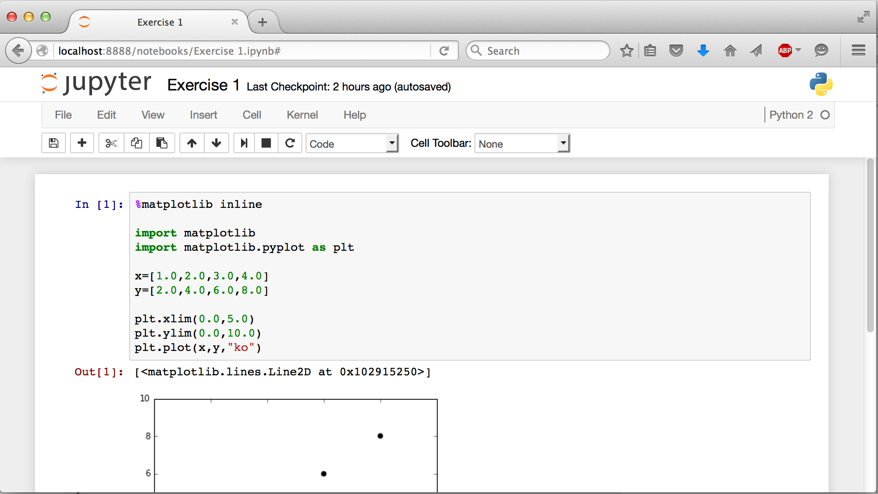
What is IPython Notebook?
“I” stands for “interactive.” It’s a way to run Python in your browser:
You can also annotate your code and share it with others. There is no difference between the Python code in IPython Notebooks and .py files.

Slide 4
How to Run Python
Option 1. Run Locally in IPython Notebook (recommended)
Code in your browser. Calculations are performed by your own computer.
You will have to install Python, but you don’t have to depend on an Internet
connection, files stay on your own computer, and calculations are free.
Option 2: Run on the Web at wakari.io
Code in your browser. Calculations are performed by computers in the cloud.
You won’t have to install any software, but you will have to pay if you are
doing anything more than a casual calculation.
Option 3: Run Locally with a Text Editor (advanced)
Code in a text editor. Calculations are performed by your own computer.
If you already have some programming background, you might prefer to
code in vim, emacs, or another text editor. This option is faster and more
versatile, but will not be covered in this tutorial.

Slide 5
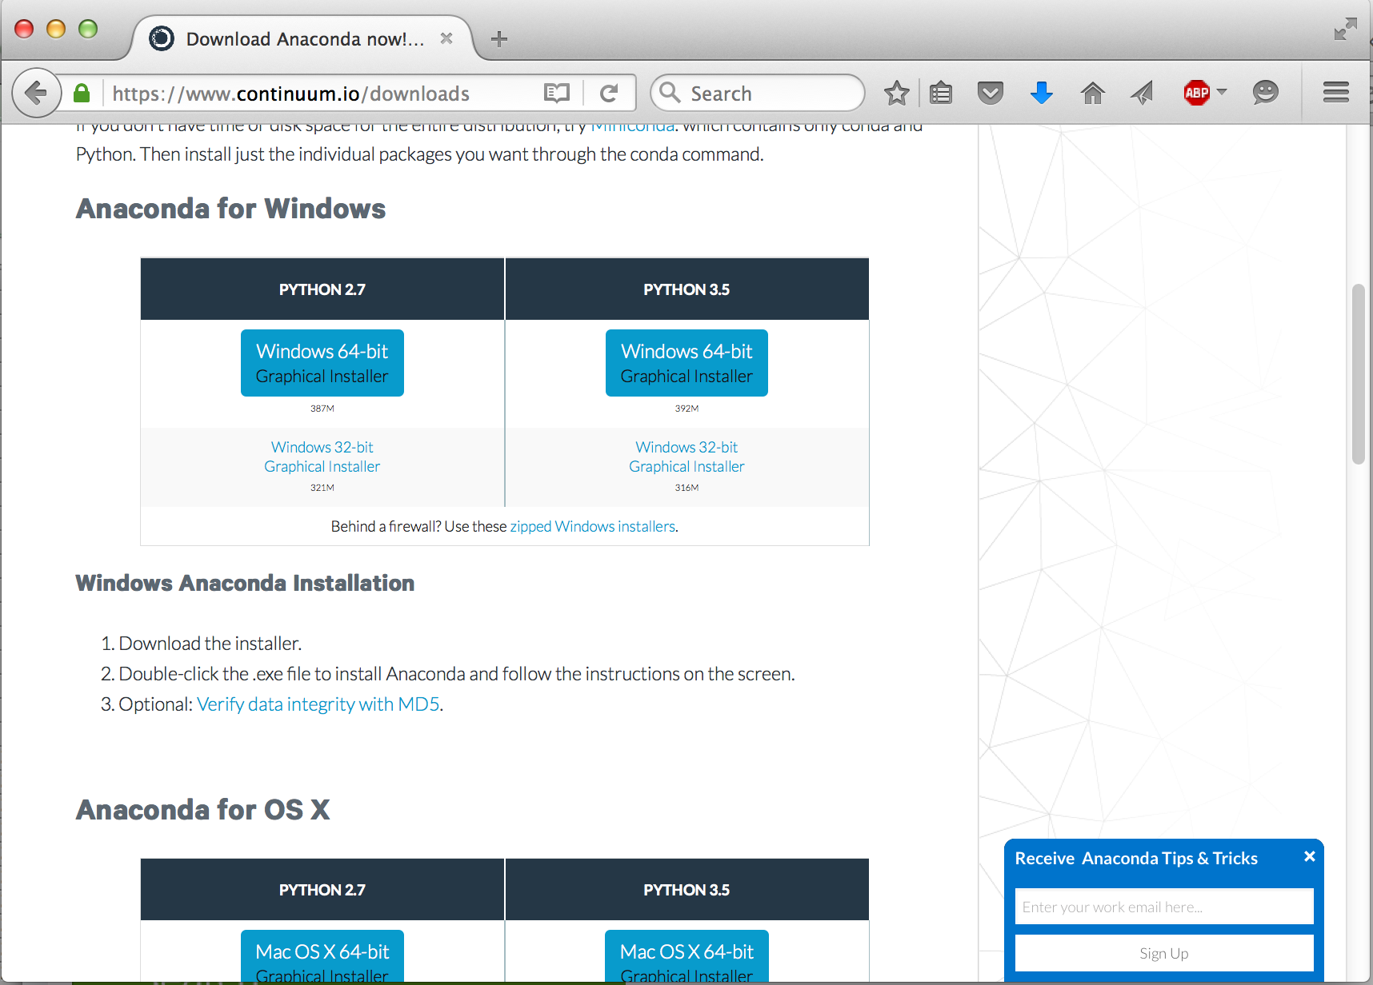
Option 1: Install Python Locally
To run Python on your own computer, download the standard Anaconda package from https://www.continuum.io/downloads.
Installers for both Windows and Mac are available. Select Python 2.7.

Slide 6
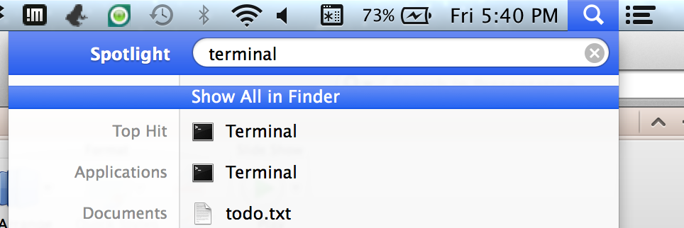
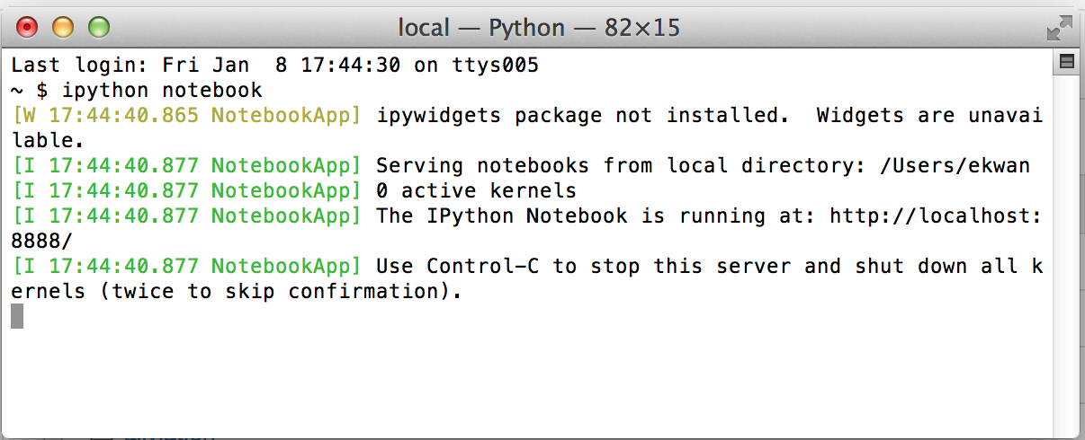
Option 1: Start Python (Mac)
To start IPython Notebook:
Open spotlight and run Terminal:
Type ipython notebook and press enter:
type here
type here

Slide 7
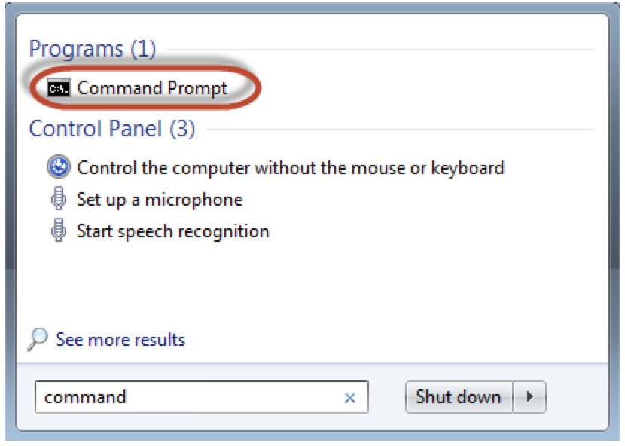
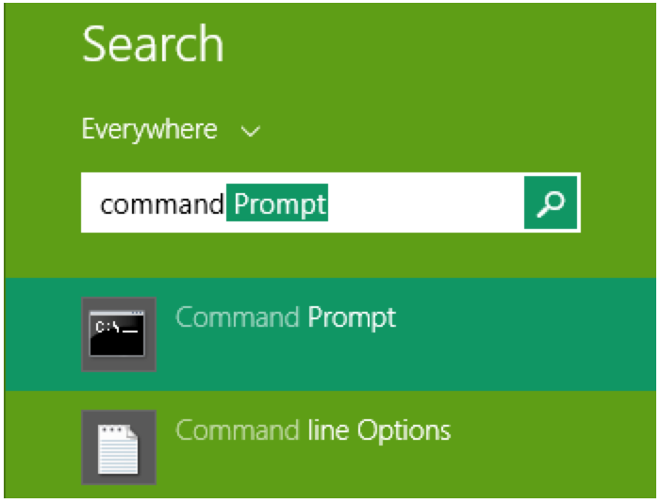
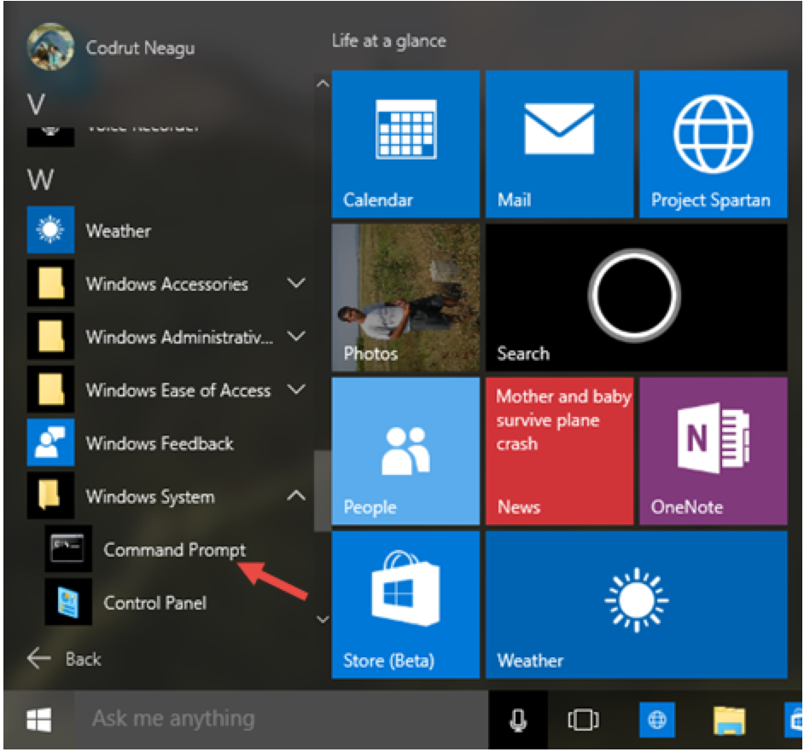
Option 1: Start Python (PC)
Open the command prompt from the Start menu (various Windows versions shown):
Click on the Start button (or its equivalent).
Search for “command prompt.” Alternatively, run cmd.
Start the prompt. A black console will open.

Slide 8
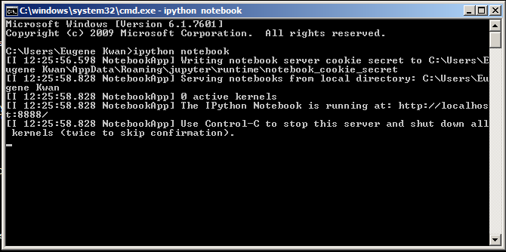
Option 1: Run Python (PC)
This is the command prompt console:
Type ipython notebook and press enter.
The Python kernel will start in the console. That’s all the text under the red box above.
IPython Notebook will start in your browser. If it doesn’t, navigate to http://localhost:8888/

Slide 9
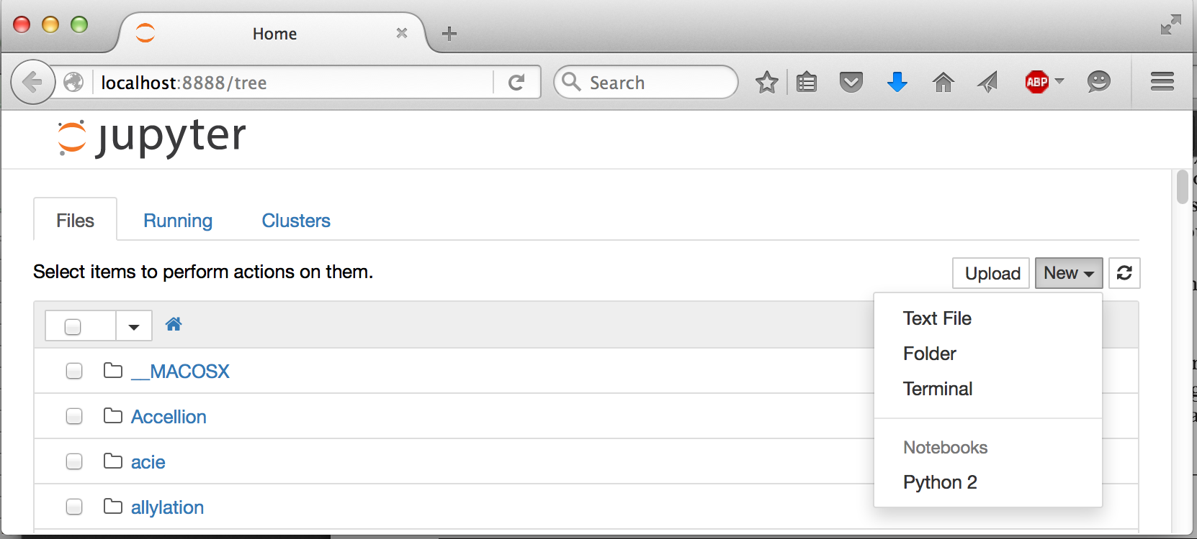
Option 1: Start a Notebook (Mac and PC)
Python will open in your browser:
click here

Slide 10
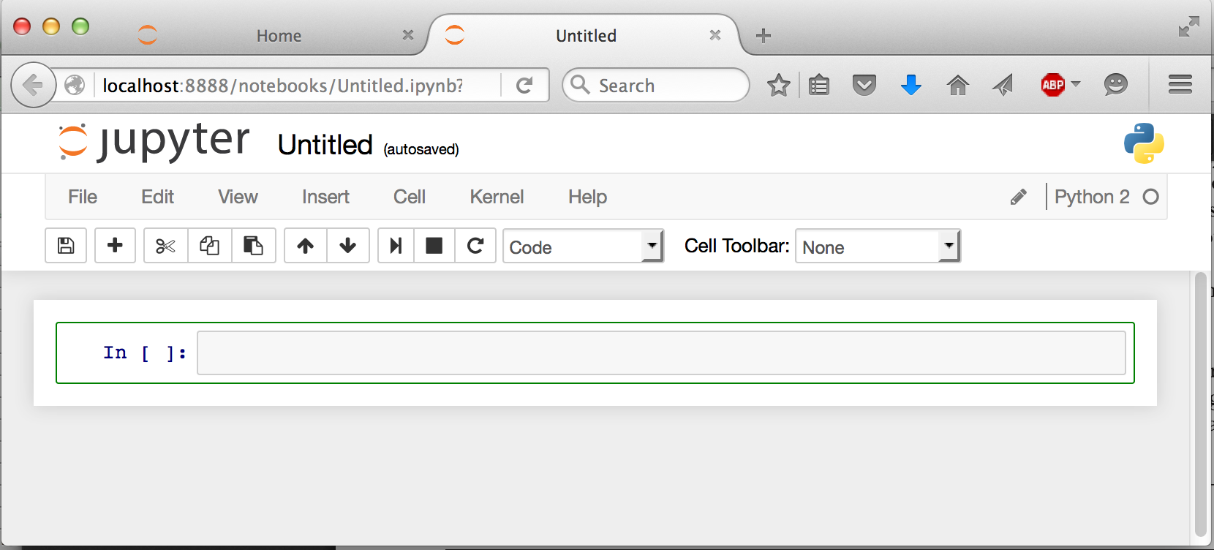
Option 1: Start a Notebook (Mac and PC)
A new tab will open:
You can start typing Python commands where indicated.
start typing here

Slide 11
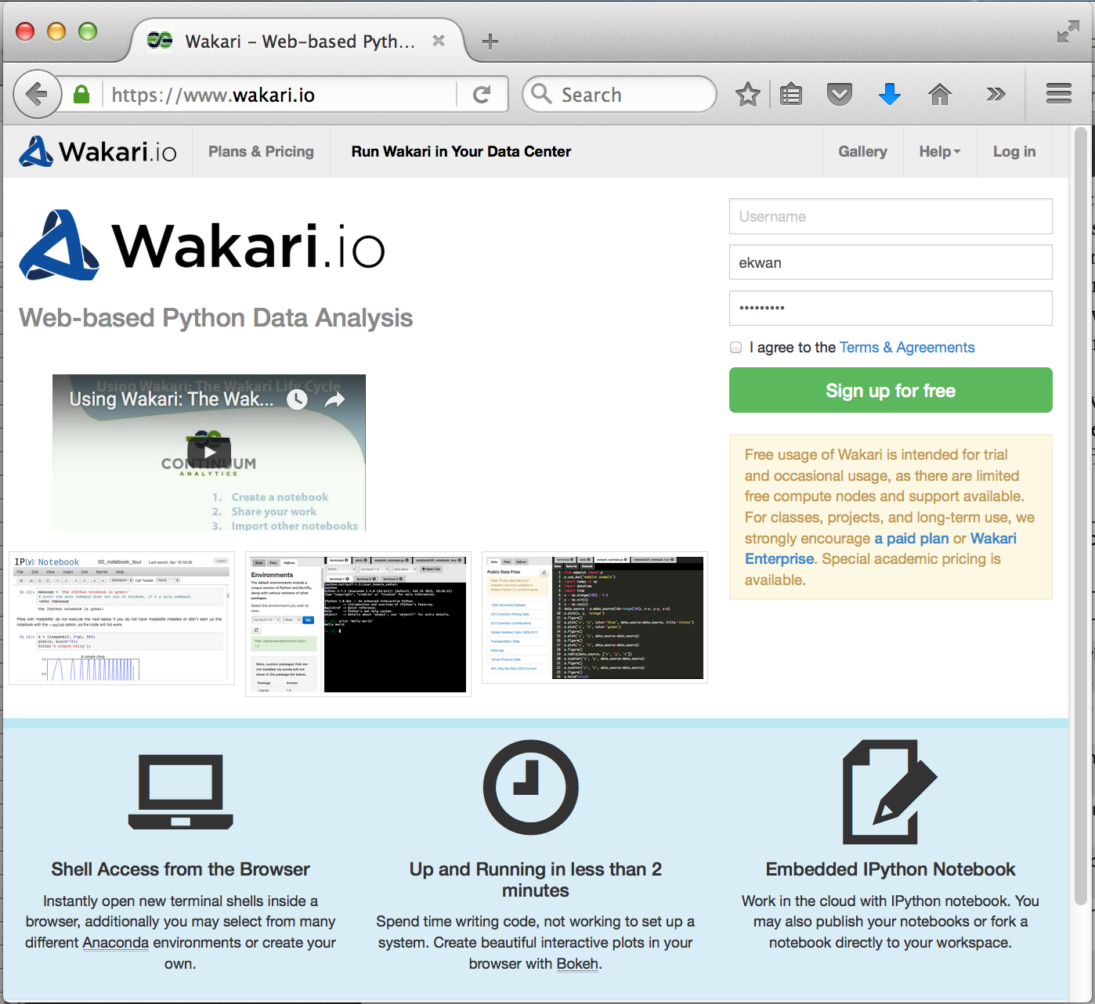
Option 2: Running on the Web
You can also run Python on the web at https://www.wakari.io
You will need to make an account before you can sign in. It’s free.
sign up
here

Slide 12
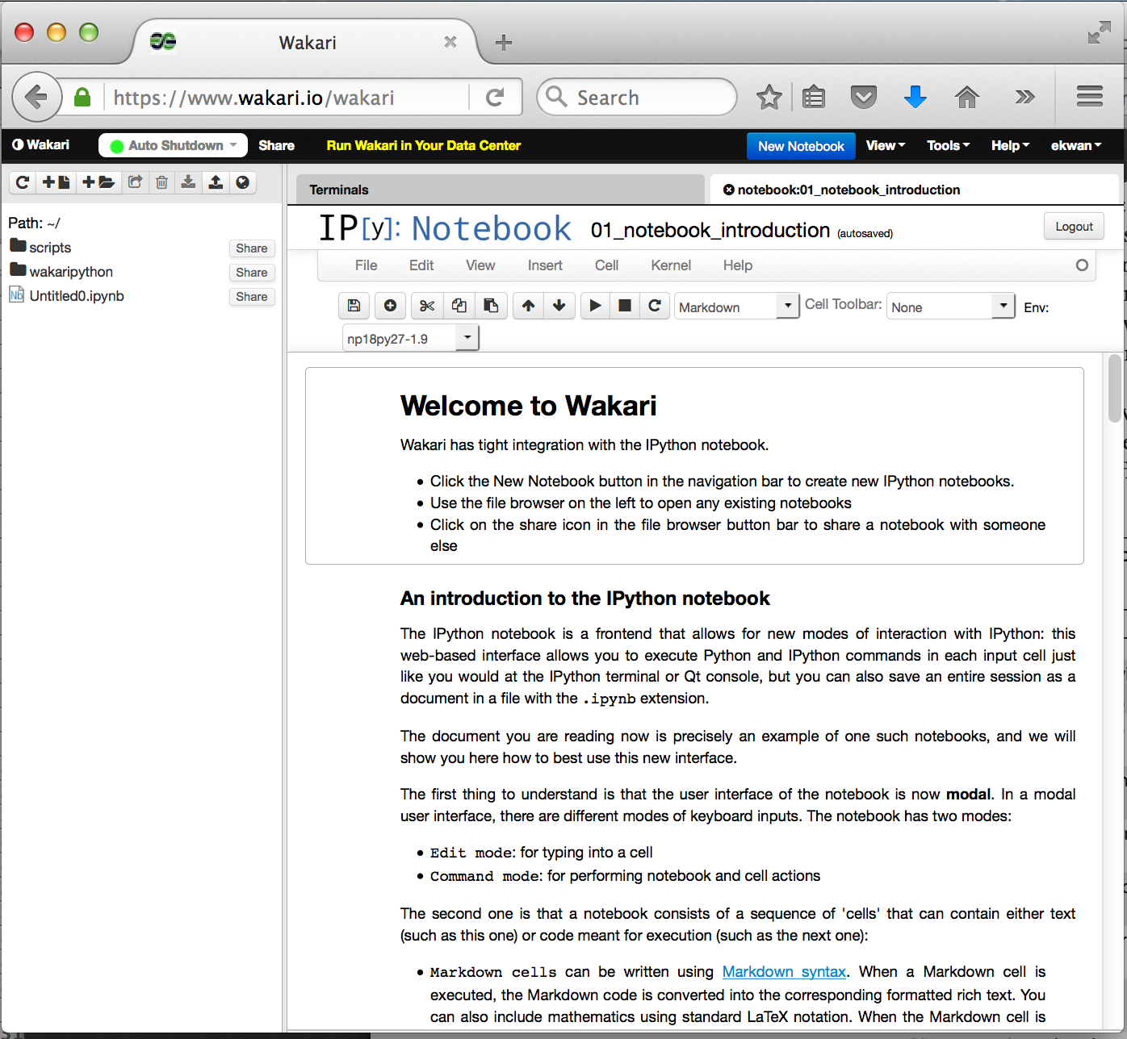
Option 2: Running on the Web
click here
When you sign in, you will see this:
Click “New Notebook” to get started.

Slide 13
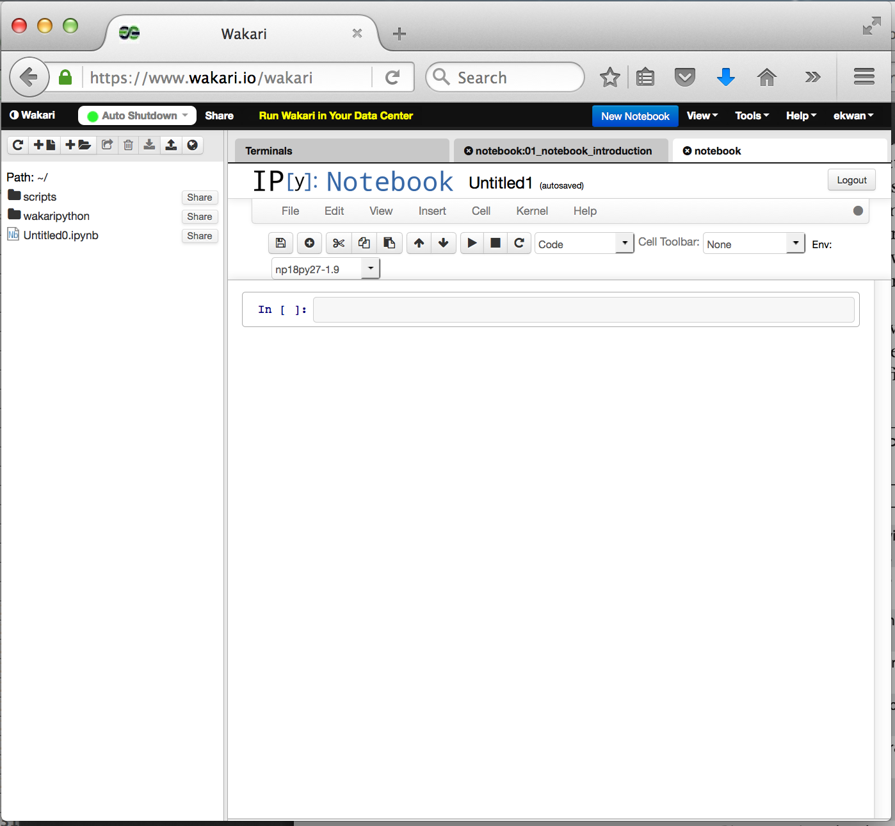
Option 2: Running on the Web
When you sign in, you will see this:
You can start typing in the indicated cell.
start typing here

Slide 14
Hello World!
To verify everything is working correctly, enter in the code below. (Don’t worry about understanding what any of it means yet.)
import numpy as np
%matplotlib inline
import matplotlib
import matplotlib.pyplot as plt
print "Hello world!"
x = np.linspace(0,2*np.pi,100)
y = np.sin(x)
plt.plot(x,y,"k")
plt.savefig("plot.png")
Notice that when you press enter, your cursor will go to the next line. To run the code, press shift-enter.
If you are copying and pasting and have a problem, try removing the blank lines in the code, which may contain some non-printing characters.

Slide 15
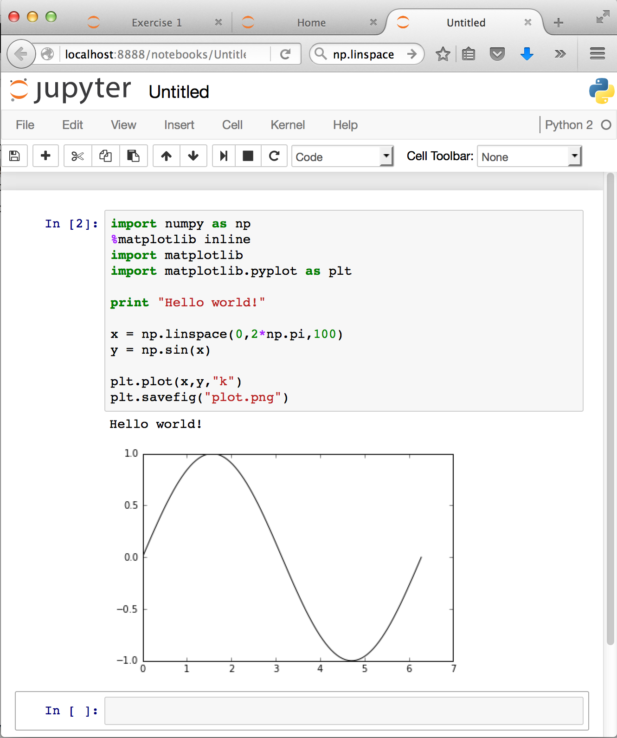
Hello World!
You should see it print out
“Hello world!” and a simple
graph (highlighted in red).
A new cell appears after
execution. You can type
in more code, or change
the code you just wrote
and run it again.
Congratulations! You just
ran your first Python
program!

Slide 16
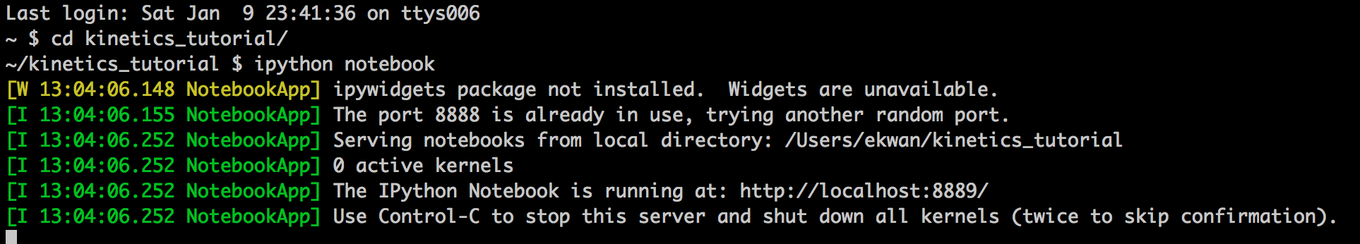
The Working Directory (Local)
When you run Python locally, notebooks will be saved into the current directory. This is determined by the directory that Python is started from.
To change it:
Mac: type cd some_directory before typing ipython notebook.
PC: type cd C:\some_directory\ before typing ipython notebook.
In the “Hello world!” script, the line plt.savefig("plot.png”) should have saved a PNG of the graph to your working directory.

Slide 17
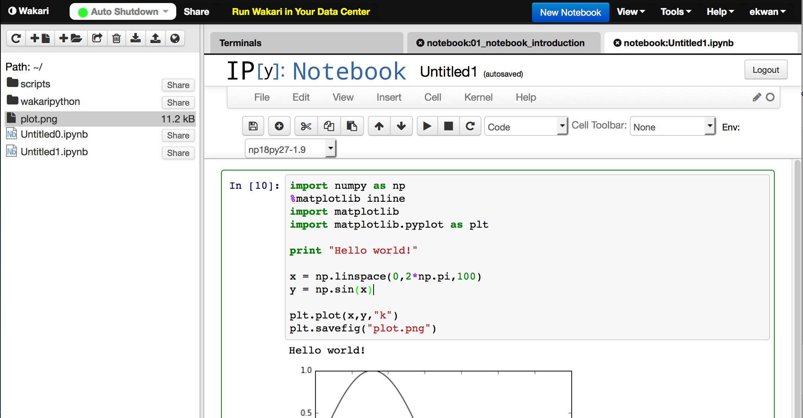
The Working Directory (Wakari)
When you run Python on Wakari, notebooks will be saved into a cloud directory, which is shown on the left hand side. Running the “Hello world!” script should create plot.png. Press the download button to copy it to your own computer.

Slide 18
Summary
Python is a free, popular, and versatile programming language for doing science. IPython Notebook lets you code in your browser.
You can run Python locally or on the cloud.
Enter code in cells. Pressing enter goes to the next line. Pressing shift-enter executes the code in the current cell.
Files will be written to the working directory. Set it before starting Python.

